Slide 1
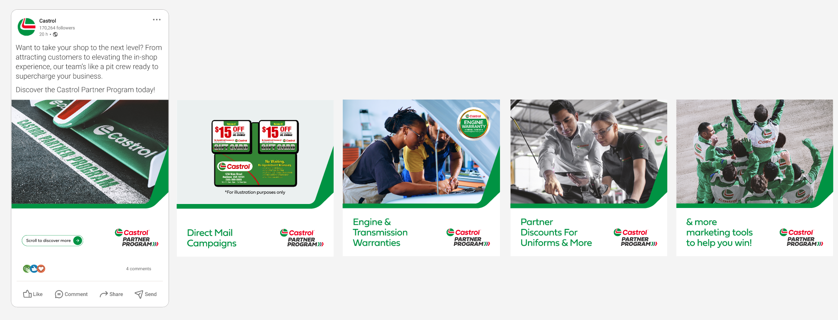
Castrol Partner Program content for LinkedIn/Facebook/Instagram – Pit Crew Carousel 1
Copy:
Want to take your shop to the next level? From attracting customers to elevating the in-shop experience, our team’s like a pit crew ready to supercharge your business.
Discover the Castrol Partner Program today: Castrol Partner Program | Castrol® USA

Slide 2
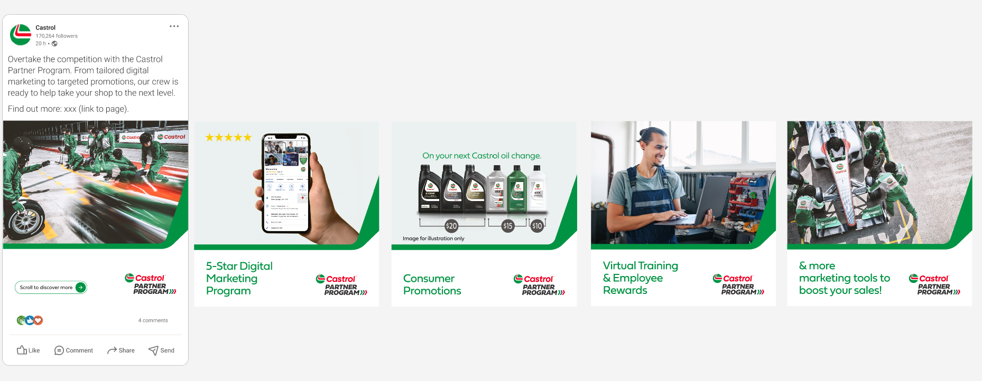
Castrol Partner Program content for LinkedIn/Facebook/Instagram – Pit Crew Carousel 2
Copy:
Overtake the competition with the Castrol Partner Program. From tailored digital marketing to targeted promotions, our crew is ready to help take your shop
to the next level. Find out more: Castrol Partner Program | Castrol® USA

